Slide 1



Capstone Project
-Team 3

Slide 2


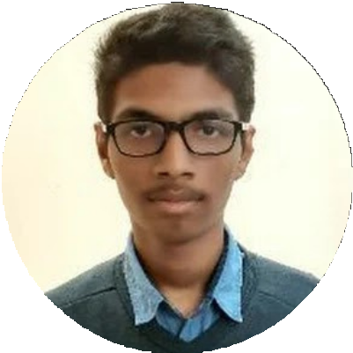
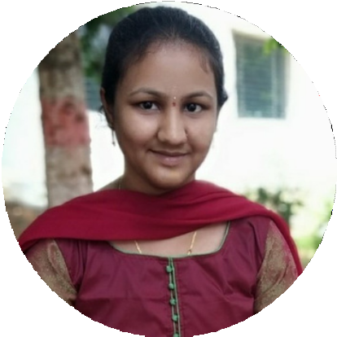
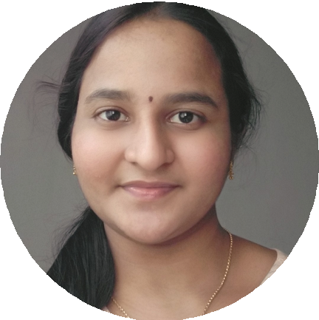







Meet Our Team
Sandeep bandaru
Mellacheruvu Harini
Likhitha Chowdary
Soumyanil Ain
Mohan Manoj Sakala
Team leader - Helmchart
Ansible
Blockdiagram and scheme
Introduction and Application
Docker and kubernetes

Slide 3


Problem Statement
Deploying a sample online voting system using K8s through containerization, container management and automating K8s through helm chart and terraform.

Slide 4




Problem Description
Online voting systems can speed up election results and lower the cost of conducting an election by significantly reducing the number of people required to operate a polling place and tabulate results. A primary concern with e-voting, however, is how to store votes so they can be recounted if required
The Online Voting System becomes more automated with the help of Cloud Eks and kubernetes and there is no need for continuous management of the portal. There is no need for third party tools in order to manage the servers when they get down with the help of kubernetes having an auto scaling feature.

Slide 5




Application Features
01
02
03
View real time result in dashboard
Vote preview
Muliple votes
Changeable order of positions to show in ballot
CRUD voters, candidates, positions
04
05
06
Print voting result in PDF

Slide 6










Technology Stack
Application language: Databases used: Design used:
Cloud Infrastructure:
PHP MySQL
Bootstrap AWS
Infrastructure Automation: Terraform
Container Runtime: Orchestrating: Package Management: Cloud services:
Docker Kubernetes
Helm Chart, Ansible
VPC, EKS, EC2, Security group
, Firewall Dockerhub, Github
Repositories:

Slide 7
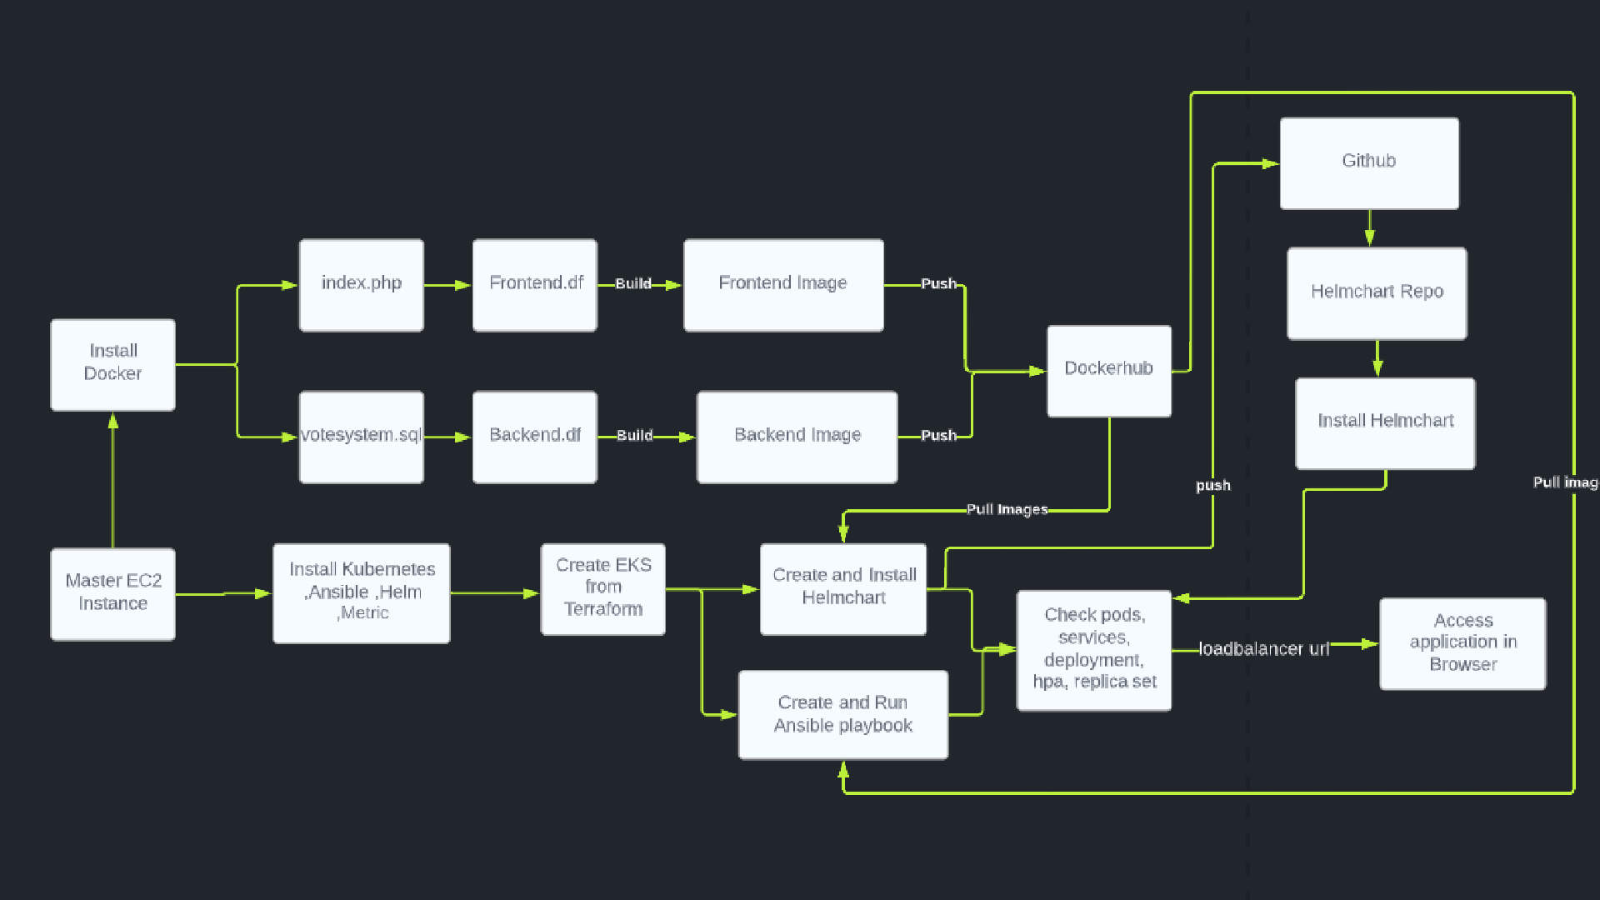
Block Diagram

Slide 8
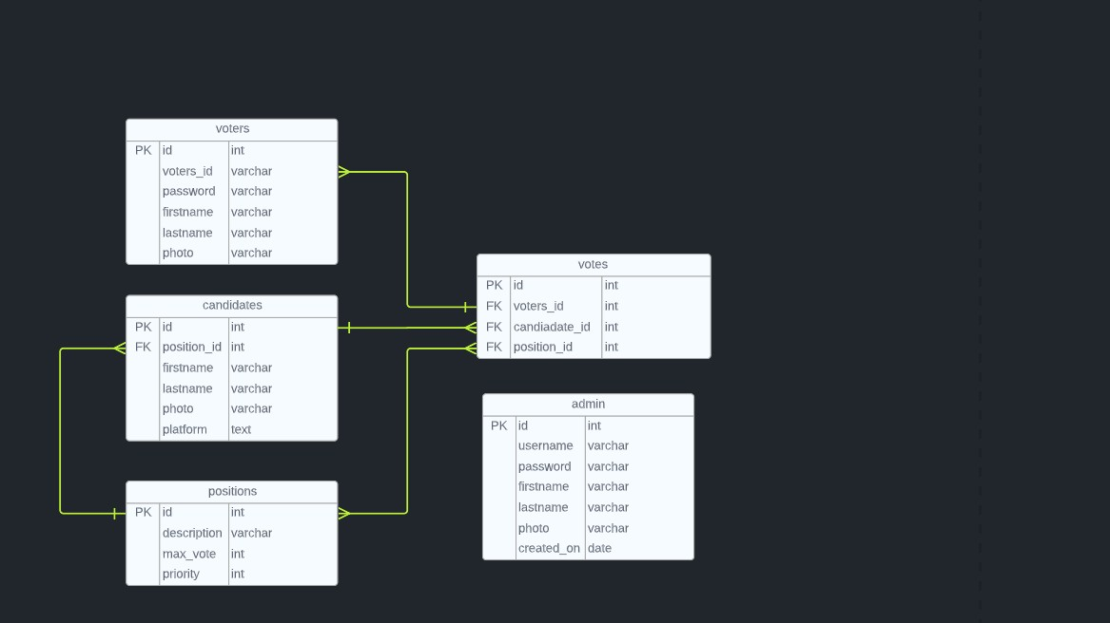

Database schema

Slide 9



Php.df
Backend.df
FROM centos:7 MAINTAINER "Team 3"
LABEL "App"="Development" RUN yum install httpd -y
RUN yum install https://dl.fedoraproject.org/pub/epel/epel- release-latest-7.noarch.rpm -y
RUN yum install http://rpms.remirepo.net/enterprise/remi- release-7.rpm -y
RUN yum install yum-utils -y
RUN yum-config-manager --enable remi-php72 -y
RUN yum install php php-mcrypt php-cli php-gd php-curl php- mysql php-ldap php-zip php-fileinfo -y
EXPOSE 80
ADD votesystem /var/www/html RUN systemctl enable httpd
CMD ["httpd", "-D", "FOREGROUND"]
FROM mysql
ENV MYSQL_DATABASE votesystem
COPY ./votesystem.sql /docker-entrypoint-initdb.d/ COPY ./alter.sql /docker-entrypoint-initdb.d/

Slide 10
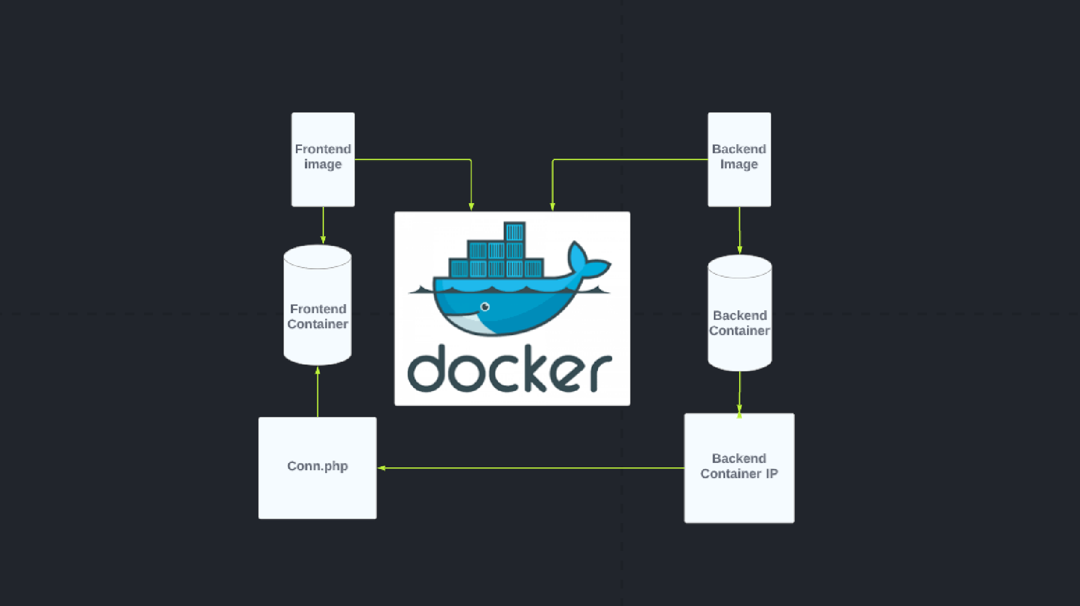


Slide 11


EKS-Cluster Using Terraform
Clone From Hashi Crop Git Hub Repo
Make Changes as per our requirement
Terraform init,plan,apply
Installing Kubernetes
Install Metric Server

Slide 12

Frontend.yaml
Backend.yaml
apiVersion: apps/v1 kind: Deployment metadata:
labels:
app: backend name: backend namespace: sandeep spec:
replicas: 1 selector:
matchLabels:
app: backend template:
metadata:
labels:
app: backend spec:
containers:
- image: sandeep9583/vote:backend name: sandeep
env:
- name: MYSQL_ROOT_PASSWORD
value: '123'
---
apiVersion: v1 kind: Service metadata: labels:
app: backend name: backend namespace: sandeep spec:
ports:
- port: 3306 protocol: TCP targetPort: 3306 selector:
app: backend type: ClusterIP
apiVersion: apps/v1 kind: Deployment metadata:
labels:
app: frontend name: frontend namespace: sandeep spec:
replicas: 1 selector:
matchLabels:
app: frontend template:
metadata:
labels:
app: frontend spec:
containers:
- image: sandeep9583/vote:frontend name: sandeep
---
apiVersion: v1 kind: Service metadata: labels:
app: frontend name: frontend namespace: sandeep spec:
ports:
- port: 80 protocol: TCP targetPort: 80 selector:
app: frontend type: LoadBalancer

Slide 13
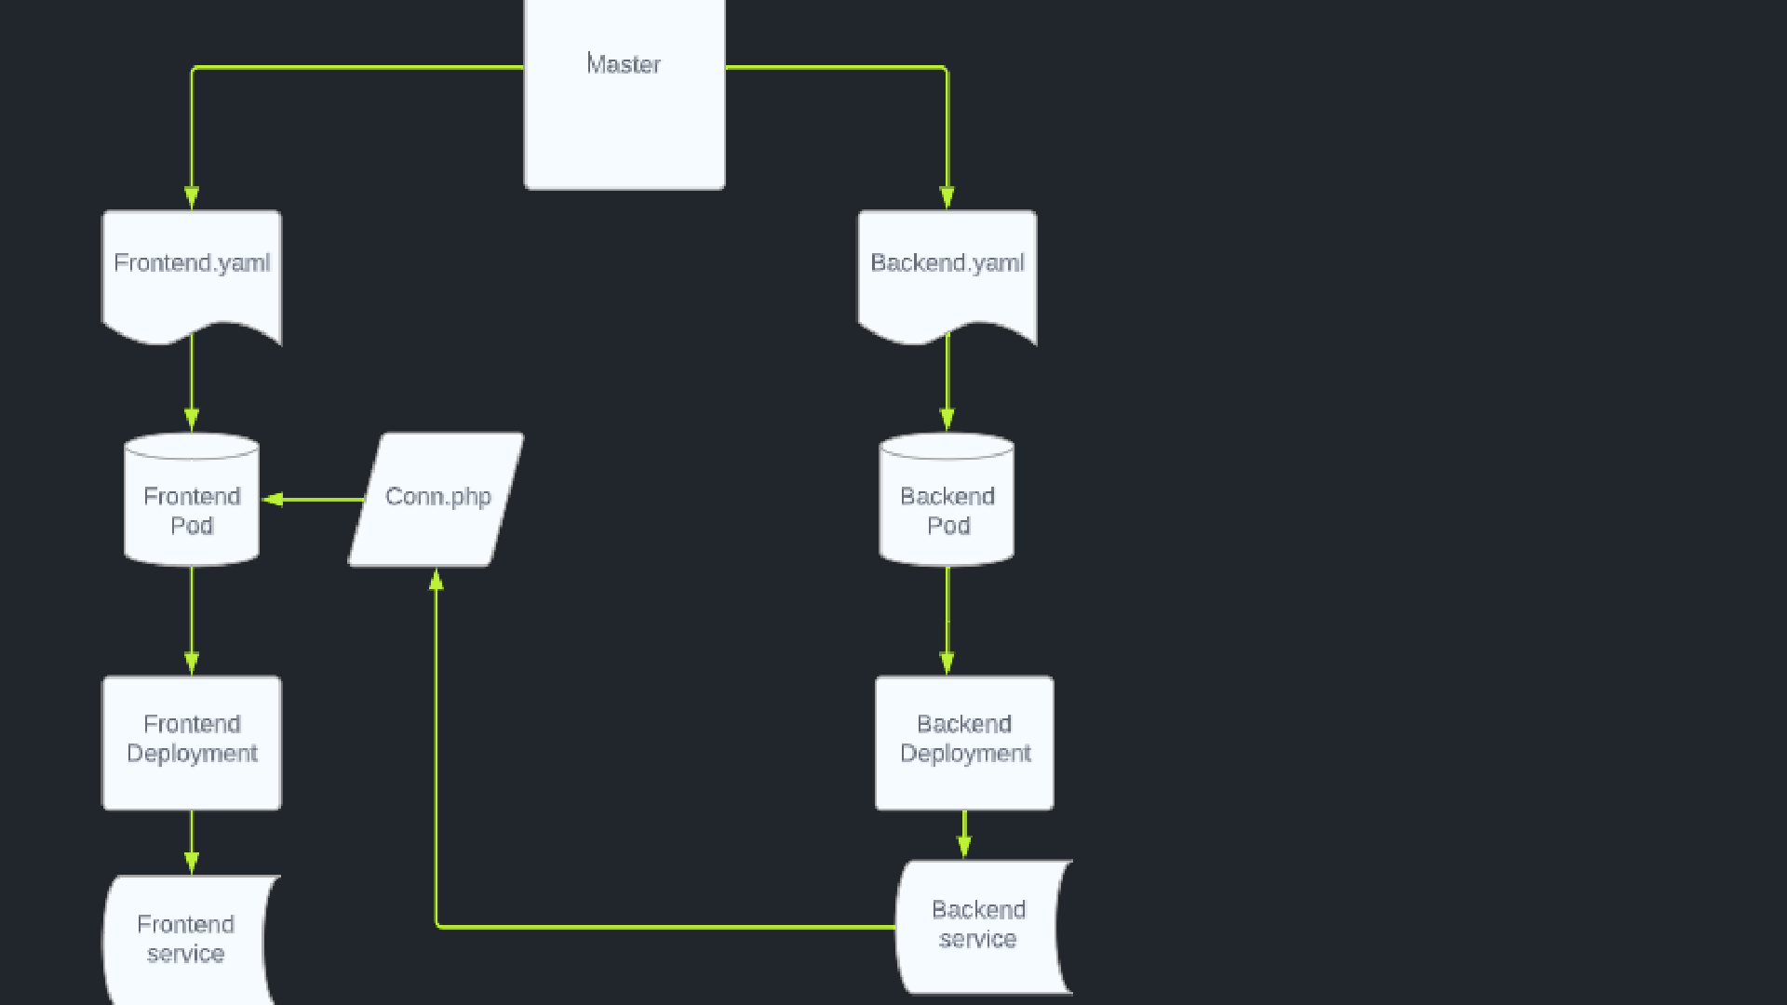


Slide 14




Playbook Tasks
Task1
- name: create namespace k8s:
name: harini api_version: v1 kind: Namespace state: present
Task2
- name: create a frontend deployment k8s:
api_version: v1 namespace: harini definition:
kind: Deployment spec:
containers:
- name: frontend
image: sandeep9583/vote:frontend resources:
limits:
cpu: 500m requests: cpu: 200m
Task3
- name: create a backend deployment k8s:
api_version: v1 namespace: harini definition:
kind: Deployment spec:
containers:
- name: backend
image: sandeep9583/vote:backend env:
- name: MYSQL_ROOT_PASSWORD
value: '123'

Slide 15


Playbook Tasks
Task4
- name: create a frontend service k8s:
api_version: v1 namespace: harini definition:
kind: Service spec:
ports:
- port: 80 protocol: TCP targetPort: 80 selector:
app: frontend type: LoadBalancer
Task5
- name: create a backend service k8s:
api_version: v1 namespace: harini definition:
kind: Service metadata: labels:
app: backend name: backend namespace: harini spec:
ports:
- port: 3306 protocol: TCP targetPort: 3306 selector:
app: backend type: ClusterIP

Slide 16
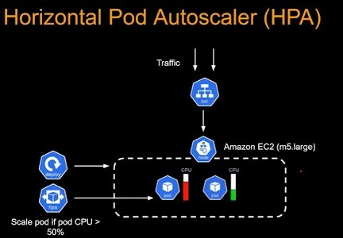
HPA

Slide 17

Playbook Tasks
Task6
-- name: Deploy hpa k8s:
api_version: v1
- name: create a frontend deployment k8s:
api_version: v1 namespace: harini definition:
kind: Deployment spec:
containers:
- name: frontend
namespace: harini definition:
kind: HorizontalPodAutoscaler metadata:
name: frontend namespace: harini spec: scaleTargetRef:
apiVersion: apps/v1 kind: Deployment name: frontend minReplicas: 2
image: sandeep9583/vote:frontend resources:
limits:
cpu: 500m requests: cpu: 200m
maxReplicas: 10
targetCPUUtilizationPercentage: 30

Slide 18



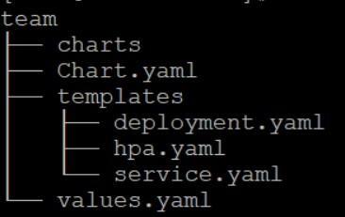
Helm Chart
Frontend
Deployment.yaml
apiVersion: apps/v1 kind: Deployment metadata:
labels:
app: {{ .Values.frontend.name}} name: {{ .Values.frontend.name}}
namespace: {{ .Values.frontend.namespace}} spec:
replicas: {{ .Values.frontend.replicaCount }} selector:
matchLabels:
app: {{ .Values.frontend.name}} template:
metadata:
labels:
app: {{ .Values.frontend.name}} spec:
containers:
- image: {{
.Values.frontend.image.repository}} name: {{ .Values.frontend.name}} resources:
limits:
cpu: 500m requests: cpu: 200m
Value.yaml
frontend:
name: frontend namespace: sandeep enabled: true replicaCount: 1 image:
repository: sandeep9583/vote:frontend
a type
hpa.yam
apiVersion: autos kind: HorizontalPod metadata:
name: {{ .Values.hpa.na namespace: {{ .Values.hpa. spec:
scaleTargetRef: apiVersion: apps/v1 kind: Deployment
name: {{ .Values.hpa.name}} minReplicas: 2
maxReplicas: 10
targetCPUUtilizationPercentage: 30
backend:
name: backend namespace: sandeep enabled: true replicaCount: 1 image:
repository: sandeep9583/vote:backend hpa:
name: frontend namespace: sandeep

Slide 19



Helm Chart
Backend
Deployment.yaml
apiVersion: apps/v1 kind: Deployment metadata:
labels:
app: {{ .Values.backend.name}} name: {{ .Values.backend.name}}
namespace: {{ .Values.backend.namespace}} spec:
replicas: {{ .Values.backend.replicaCount }} selector:
matchLabels:
app: {{ .Values.backend.name}} template:
metadata:
labels:
app: {{ .Values.backend.name}} spec:
containers:
- image: {{ .Values.backend.image.repository}} name: {{ .Values.backend.name}}
env:
- name: MYSQL_ROOT_PASSWORD
value: "123"
Value.yaml
frontend:
name: frontend namespace: sandeep enabled: true replicaCount: 1 image:
repository: sandeep9583/vote:frontend
n spec ports:
- port: 33 protocol: TC targetPort: 33 selector:
app: {{ .Values.backe type: ClusterIP
backend:
name: backend namespace: sandeep enabled: true replicaCount: 1 image:
repository: sandeep9583/vote:backend hpa:
name: frontend namespace: sandeep

Slide 20
Steps for Installing Helm Charts from Repositories
helm search repo votesystem_helm/team
helm install <Any name> votesystem_helm/team
watch kubectl get all

Slide 21
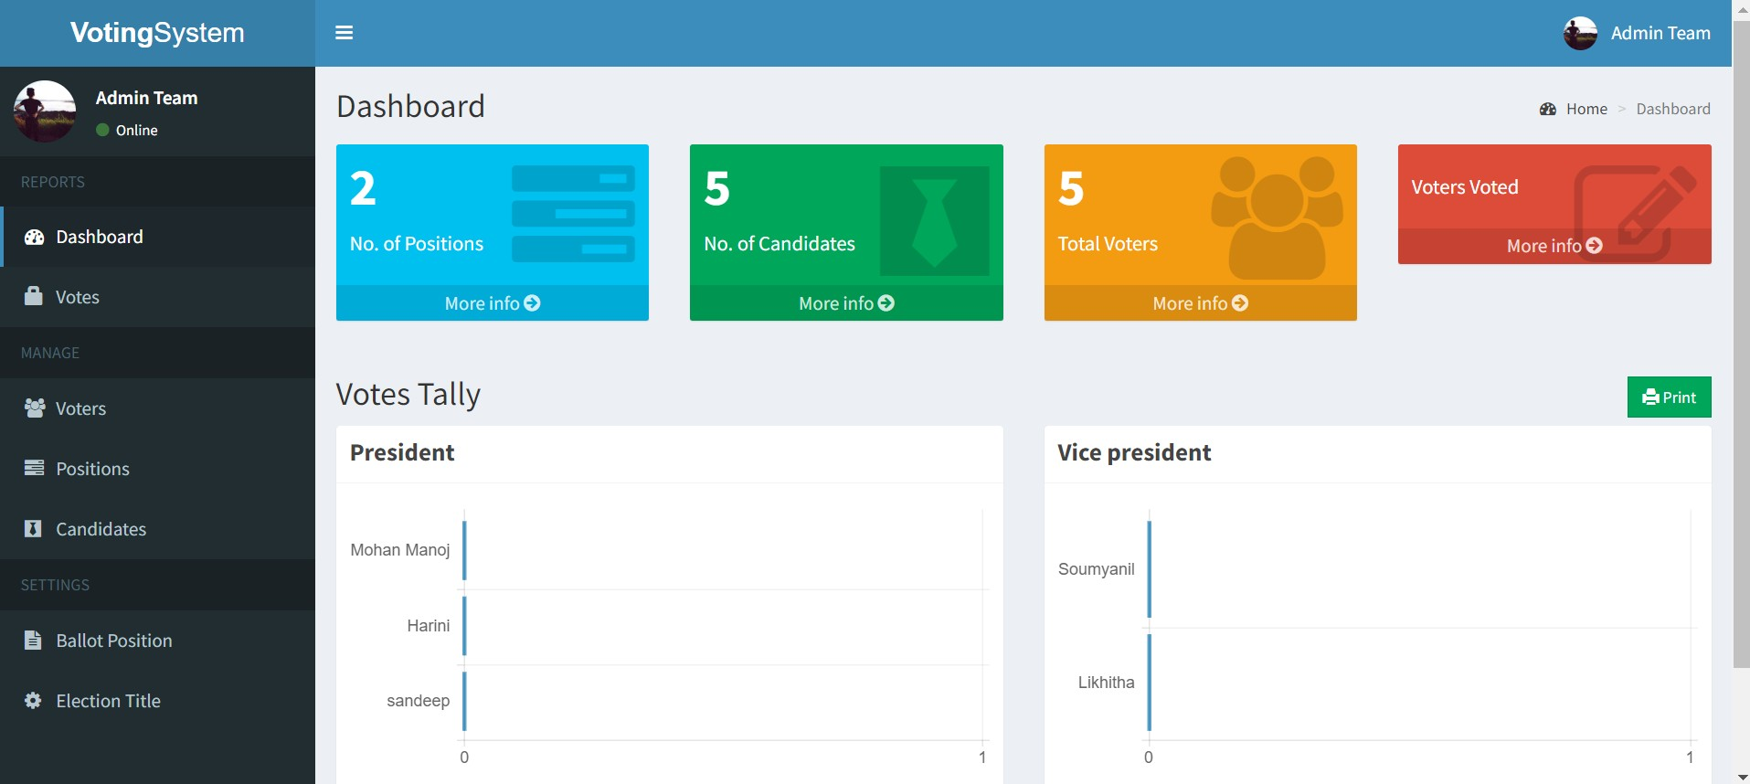
Application Admin Page

Slide 22
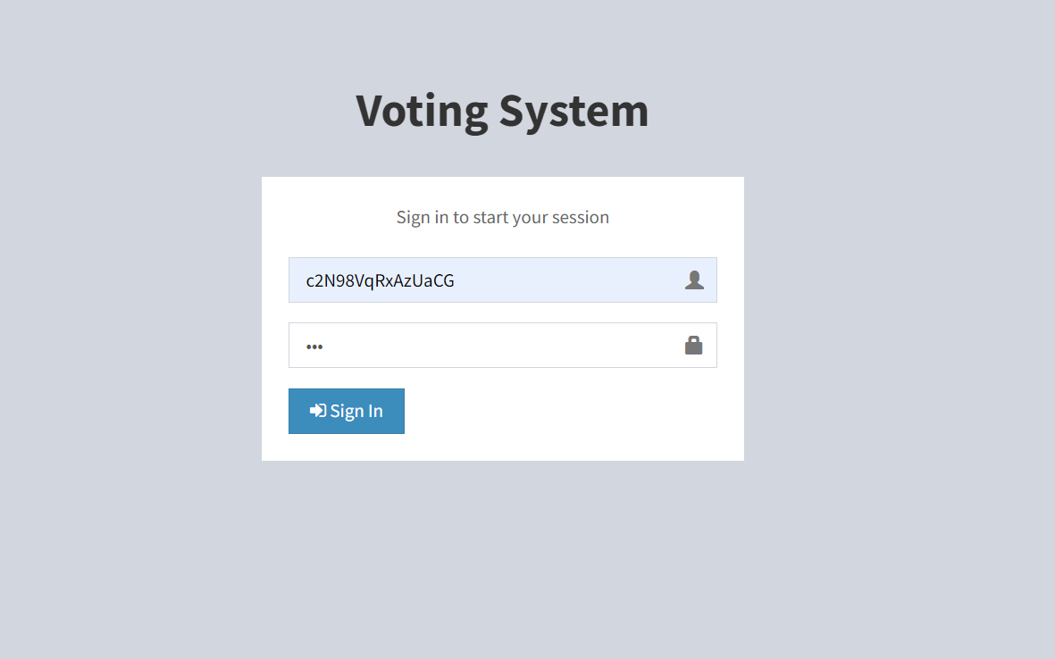
Application Login Page

Slide 23
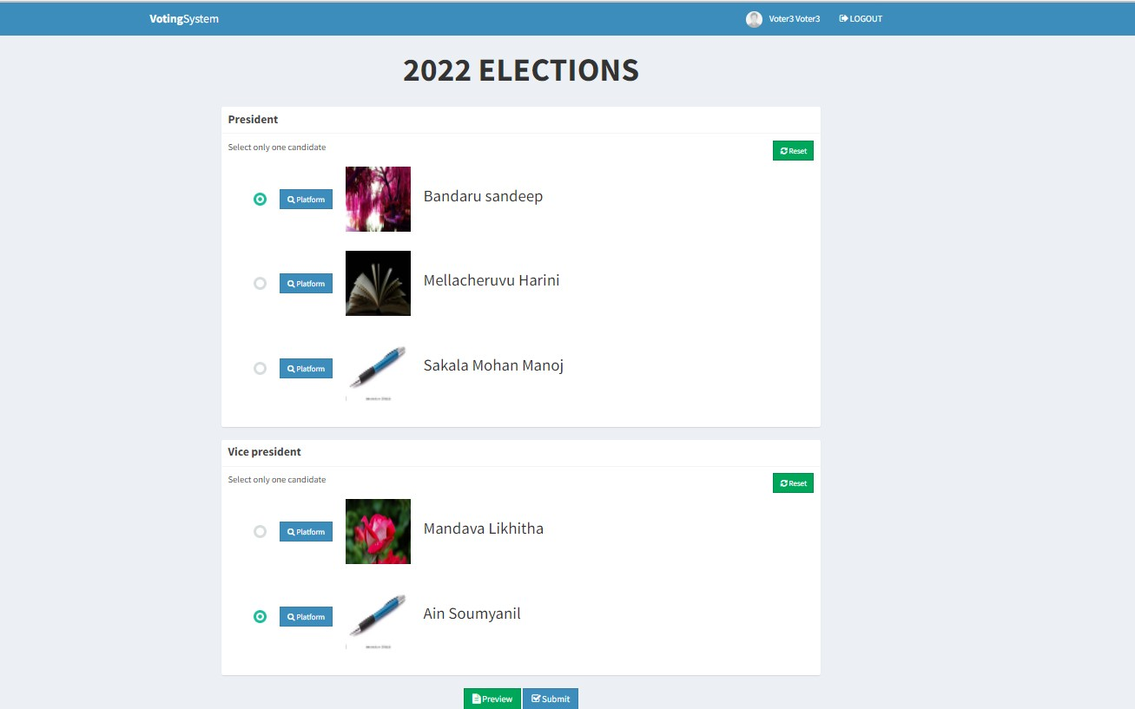
Application Voter Page

Slide 24
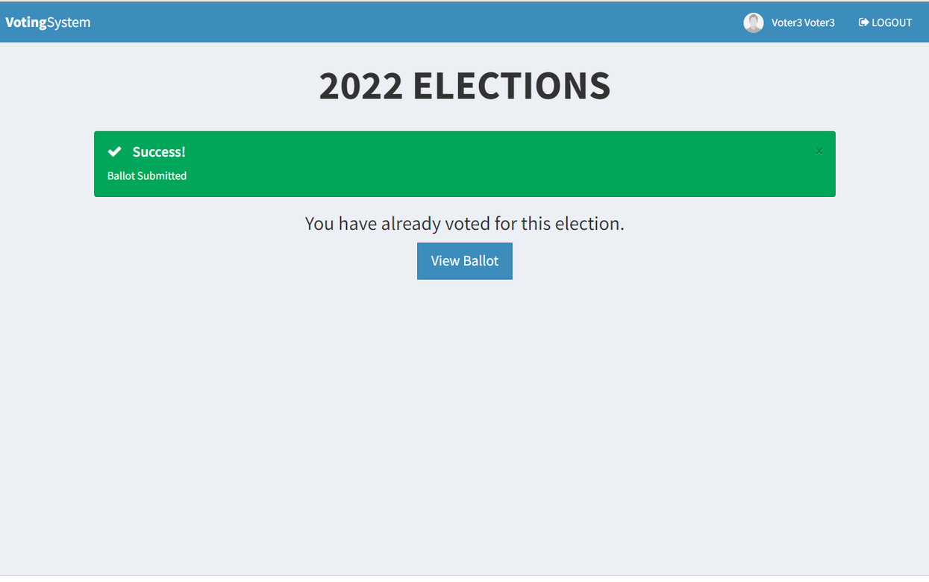
Success Page After Voting

Slide 25
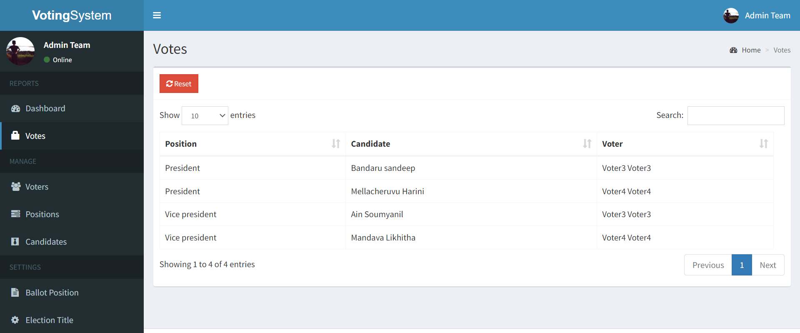
Result Webpage after Casting the Vote

Slide 26
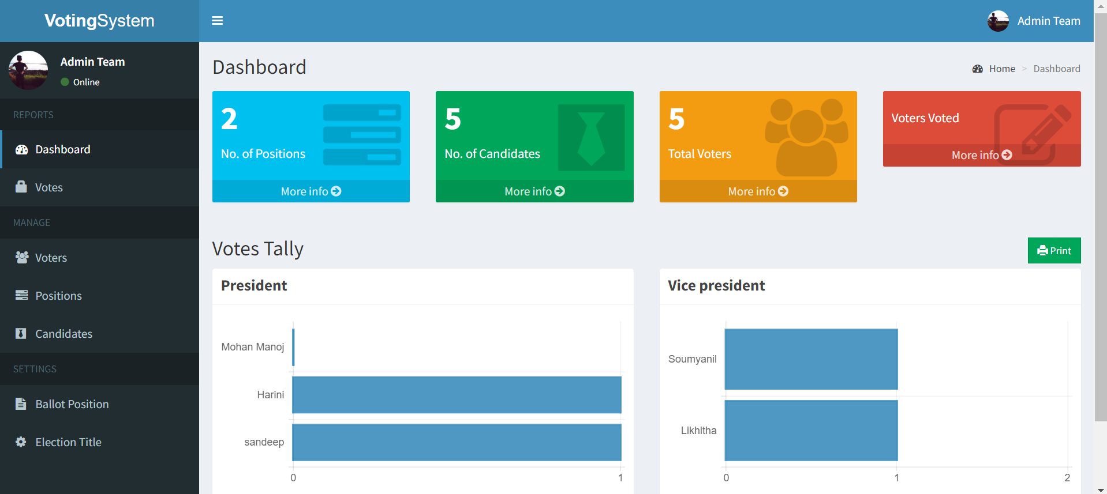
Admin Dashboard After Polling

Slide 27
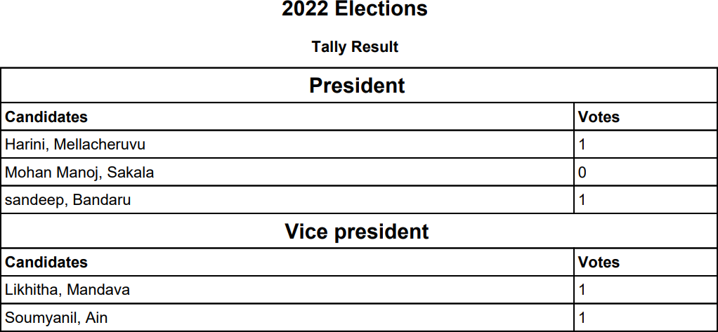
Result Pdf

Slide 28







Summary
"By summarizing the project,our team has succesfully deployed a sample online voting system using K8s through containerization, container management and automating K8s through helm chart/terraform and with the help of above technology stack like AWS,terraform,docker,Ansible,helm charts."

Slide 29





Thank You

